Slide 1
Project 2: The Natural History and Measurement of Power Mobility Among Older Adults
CanWheel
AGM at RESNA
June 2014
Paula Rushton, OT, PhD

Slide 2
Team members
P2: Natural Hx & Measurement
Team Leads & Members
Research Assistants
Bill Miller
Louise Demers
Jan Miller-Polgar
Alex Mihailidis
Francois Routhier
Cher Smith
Lee Kirby
Ben Mortenson
Claudine Auger
Kate Keetch
Sarah McCuaig
Jenn Querques
Laura Titus
Fabrizio Farronato
Elise Busilacchi
Marie-Pierre Johnson
Deborah Stewart

Slide 3
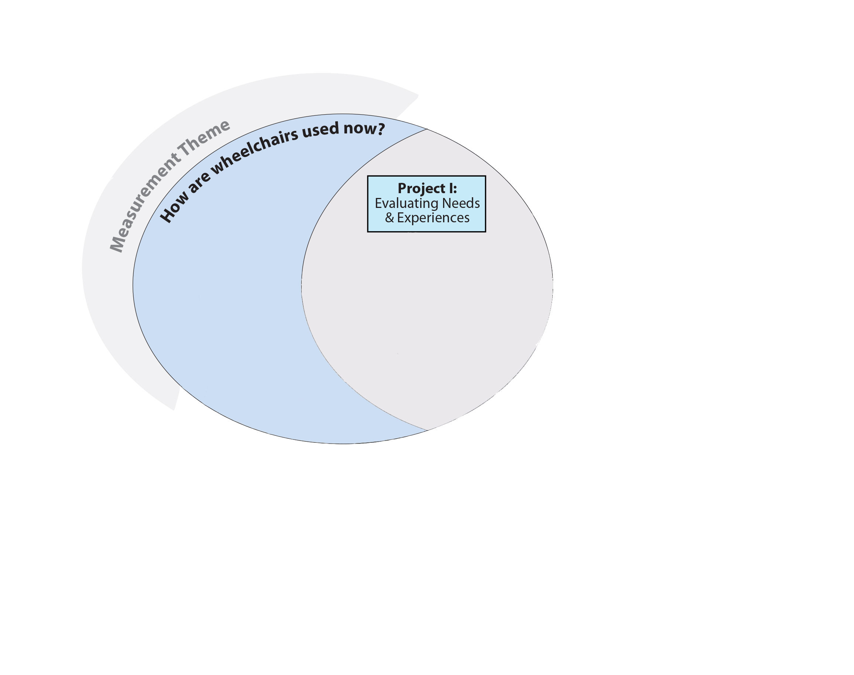
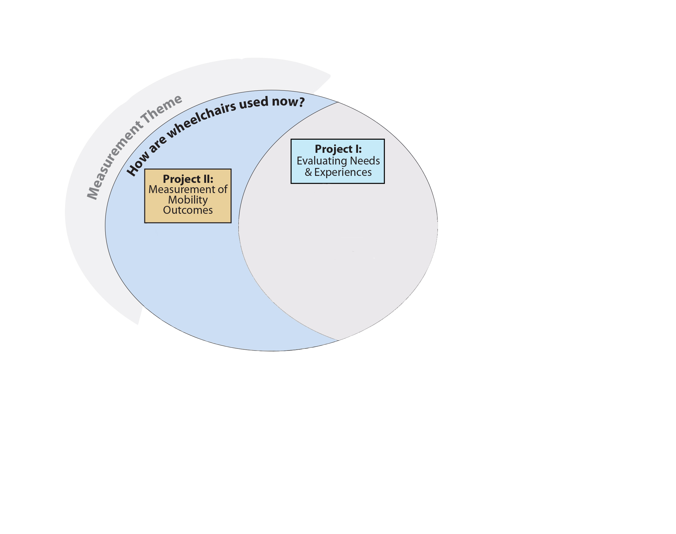
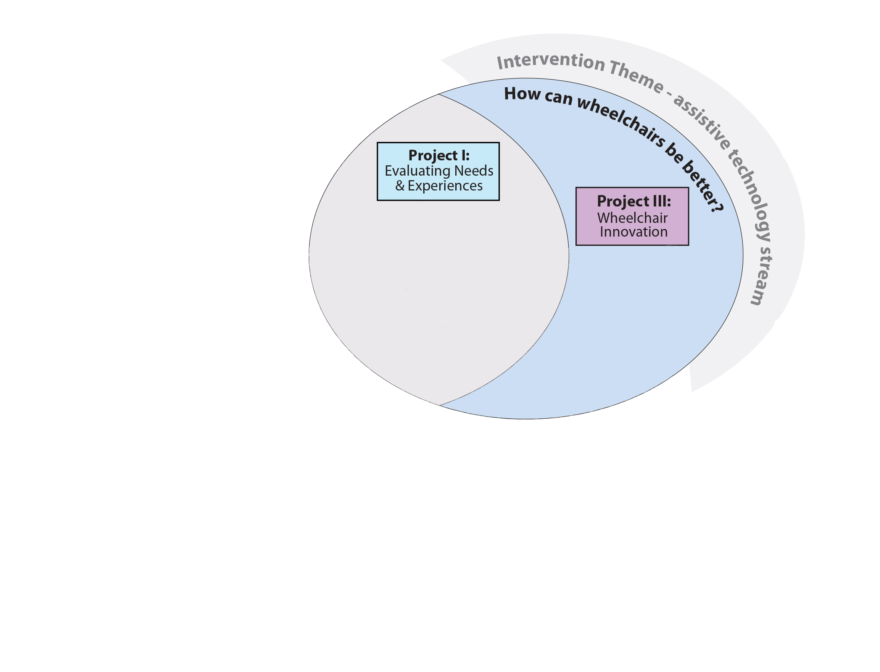
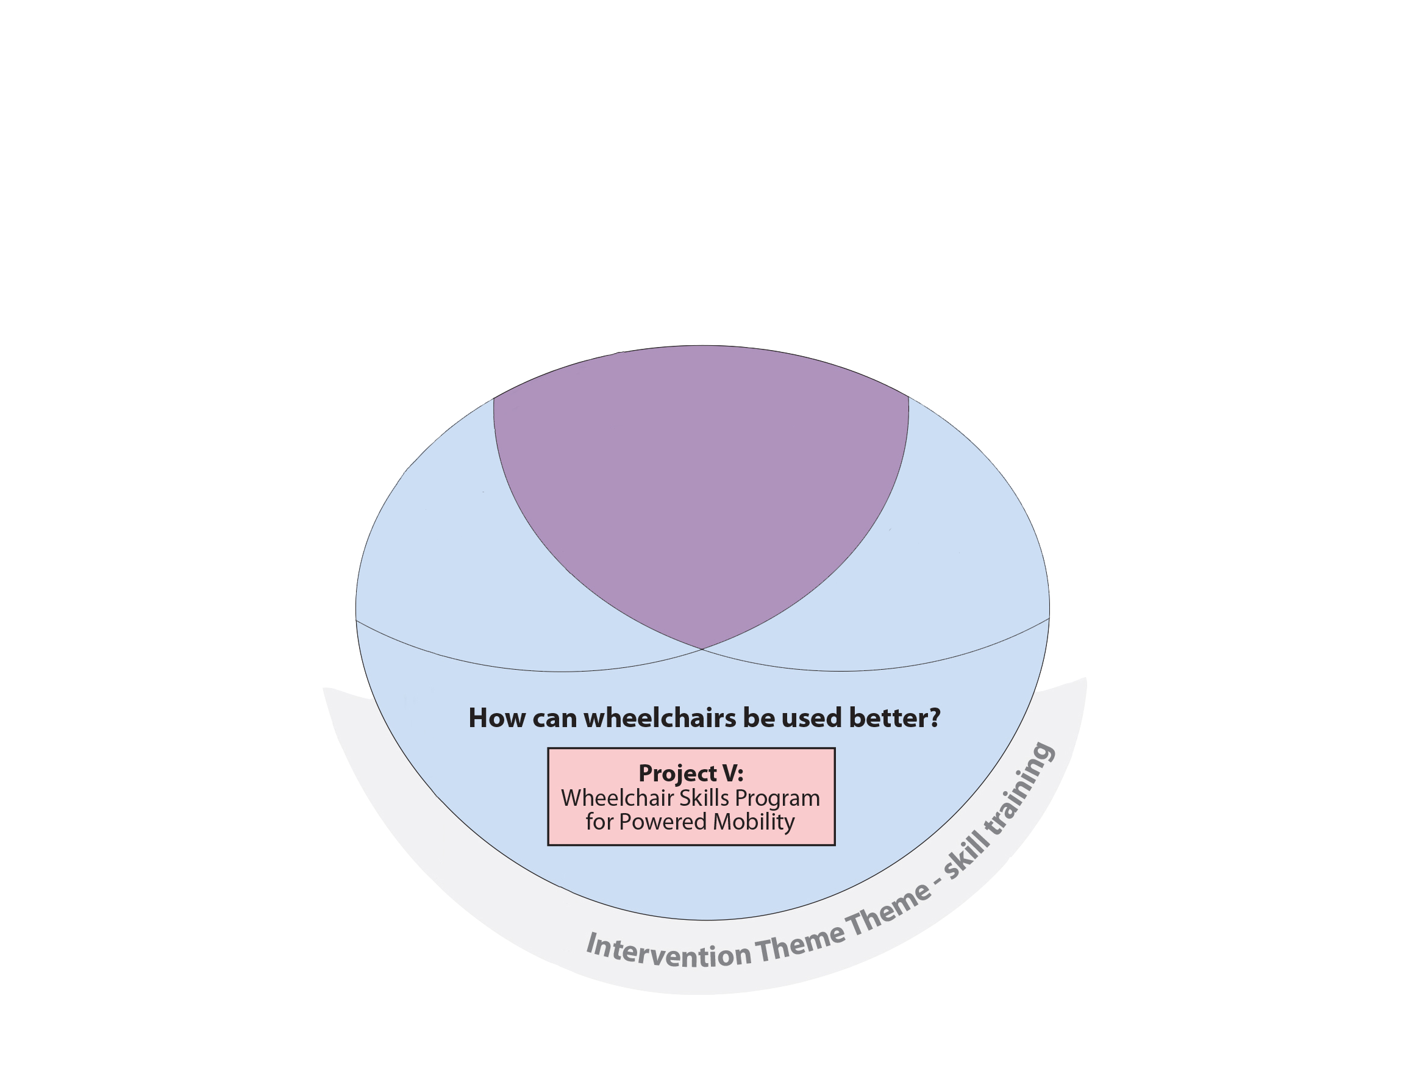
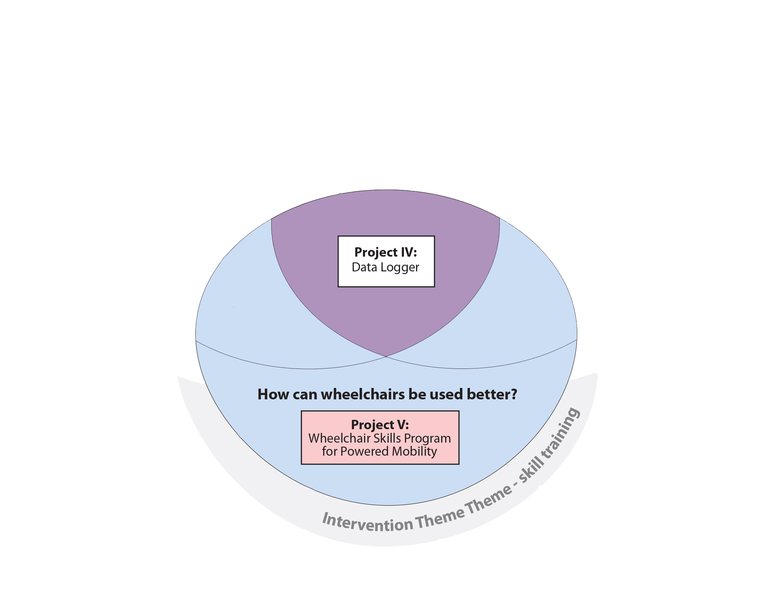
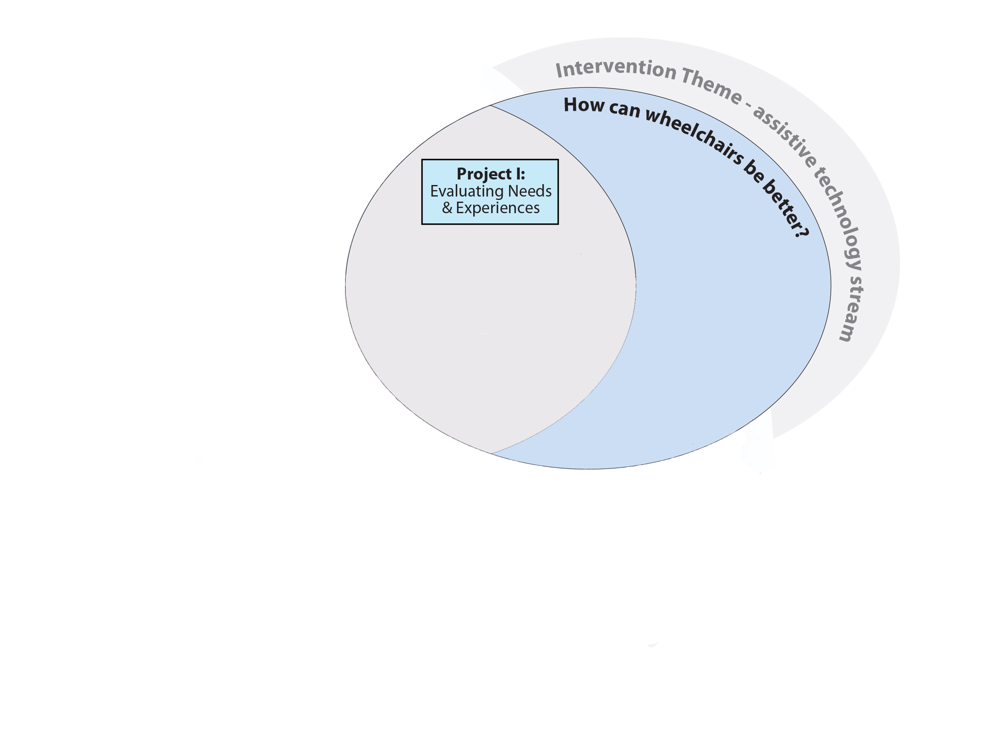
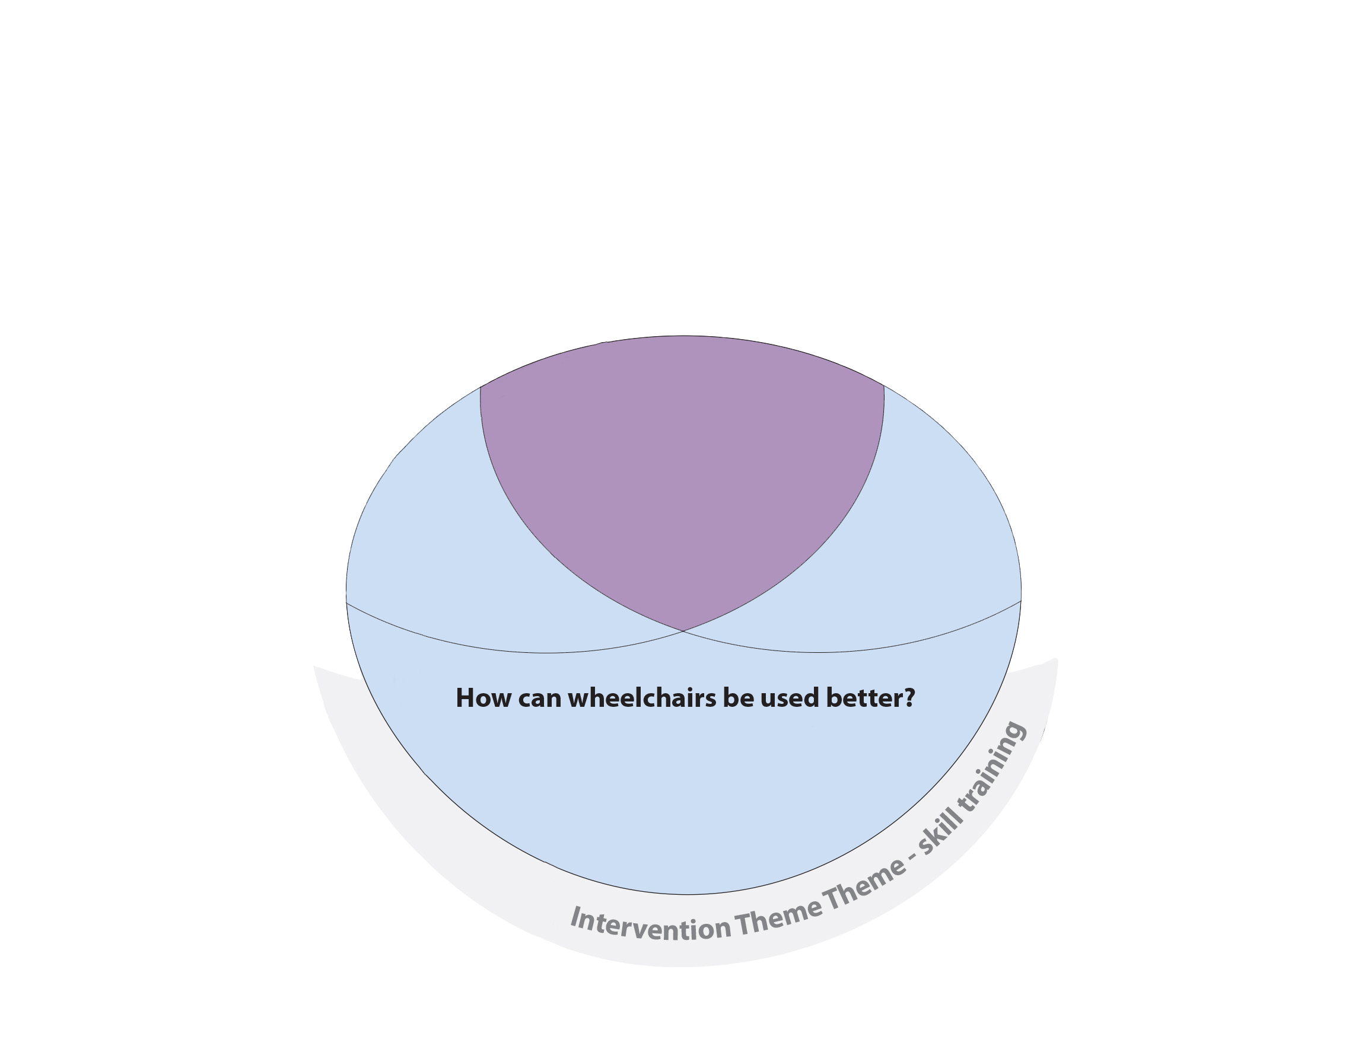
P2: Natural Hx & Measurement
Project I:
Evaluating Needs
& Experiences
Project I:
Evaluating Needs
& Experiences
Project II:
Measurement of
Mobility
Outcomes
Project III:
Wheelchair
Innovation
Project IV:
Data Logger
Project V:
Wheelchair Skills Program
For Powered Mobility
Notes:
To accomplish this goal, we are conducting 5 research projects organized under 2 themes to answer 3 questions. The 2 themes are measurement and intervention. Under the intervention theme we have 2 streams: skills training and assistive technology development. Our 3 questions are: (1) How are power wheelchairs used now?; (2) How can power wheelchairs be used better?; (3) How can power wheelchairs be better? The 5 projects include… As you can see from our framework / schematic the results of each of the projects inform the others to varying degrees and also in varying ways. So now I’ll briefly take you through the 5 research projects. Each are in a different phase, ranging from completed to early stages. First I’ll address the Question of How are Power Wheelchairs Used Now? And take you through 3 projects…

Slide 4
P2: Natural Hx & Measurement
Project II:
Measurement of
Mobility
Outcomes
Project I:
Evaluating Needs
& Experiences
Project II:
Measurement of
Mobility
Outcomes
Project III:
Wheelchair
Innovation
Project IV:
Data Logger
Project V:
Wheelchair Skills Program
For Powered Mobility

Slide 5
P2: Natural Hx & Measurement
Project III:
Wheelchair
Innovation
Project I:
Evaluating Needs
& Experiences
Project II:
Measurement of
Mobility
Outcomes
Project III:
Wheelchair
Innovation
Project IV:
Data Logger
Project V:
Wheelchair Skills Program
For Powered Mobility

Slide 6
P2: Natural Hx & Measurement
Project IV:
Data Logger
Project I:
Evaluating Needs
& Experiences
Project II:
Measurement of
Mobility
Outcomes
Project III:
Wheelchair
Innovation
Project IV:
Data Logger
Project V:
Wheelchair Skills Program
For Powered Mobility

Slide 7
P2: Natural Hx & Measurement
Project V:
Wheelchair Skills Program
For Powered Mobility
Project I:
Evaluating Needs
& Experiences
Project II:
Measurement of
Mobility
Outcomes
Project III:
Wheelchair
Innovation
Project IV:
Data Logger
Project V:
Wheelchair Skills Program
For Powered Mobility

Slide 8
Purpose
P2: Natural Hx & Measurement
Objective # 1: To assess the reliability and validity of a Power Wheelchair Outcomes Tool Kit.
Objective # 2: To describe the natural history of power wheelchair use over a 2 year period in older adults who use a power wheelchair and their caregivers.

Slide 9
METHODS
P2: Natural Hx & Measurement
Multi-site, Multi-cohort, 2 Year Longitudinal Study

Slide 10
Sites
P2: Natural Hx & Measurement
Vancouver
Halifax
Toronto
Québec
London
Montréal
Notes:
This group has developed a program of research with the ultimate goal of improving the wheeled mobility of older adults. The team is funded by CIHR for a 6 year grant, of which Bill Miller is the PI. Five projects will be completed during this 6 yr period. Today I’m going to talk to you about part of one of these projects, but if you’re interested in learning more about this team and the work, website www.canwheel.ca.

Slide 11
P2: Natural Hx & Measurement
Cohorts / Participants
Power Wheelchair Users (PWU) |  | Caregivers
New | Experienced
≥ 50 years old | ≥ 50 years old | ≥ 19 years old
Able to operate power wheelchair independently | Able to operate power wheelchair independently | Provide a minimum of 2 hours of care on a weekly basis
≤ 1 month of experience | ≥ 6 months experience | Provides care for a PWU that is ≥ 50 years old
Able to travel to testing site for 2/7 testing occasions | Able to travel to testing site for 2/7 testing occasions | Be an ‘informal’ caregiver
Exclusion Criteria: Unable to speak, read, & write in English or French

Slide 12
Procedure
P2: Natural Hx & Measurement
All Sites
Vancouver
Only

Slide 13
What do we measure?
P2: Natural Hx & Measurement
The Consortium on Assistive Technology Outcomes Research (CATOR) Framework (Jutai et al, 2005)
Assistive Technology Device Outcome Vantage
Effectiveness | Social Significance | Subjective Well-Being
ICF Functioning ICF Contextual Factors User Longevity | Caregiving Cost Residential Care Placement Service Utilization Device Utilization | Psychological Functioning Quality of Life Satisfaction
Notes:
EFFECTIVENESS: objectively examines the impact of the PWC at the individual wheelchair user’s level with a focus on functioning in activities and participation
SOCIAL SIGNIFICANCE: examines the impact of the PWC on society, from the caregiver perspective.
SUBJECTIVE WELL-BEING: examines the impact of the PWC on psychological functioning (e.g. confidence) and quality of life (e.g., perceived participation).

Slide 14
Power Wheelchair Outcomes Tool Kit
P2: Natural Hx & Measurement
Assistive Technology Device Outcome Vantage
Effectiveness | Social Significance | Subjective Well-Being
Wheelchair Skills Test (WST) Wheelchair Skills Test Questionnaire (WST-Q) Data Logger Life Space Assessment (LSA) | Caregiver Assistive Technology Outcome Measure (CATOM) | Assistive Technology Outcomes Profile for Mobility (ATOP/M) Wheelchair Use Confidence Scale (WheelCon)
Plus… qualitative interviews (baseline, 1, 4, & 25 mo)

Slide 15
RESULTS
P2: Natural Hx & Measurement

Slide 16
Current Quantitative Data Collection Status
P2: Natural Hx & Measurement
 | T1 | T2 | T3 | T4 | T5 | T6 | T7
Exp. PWU | 103 | 95 | 96 | 95 | 89 | 33 | 27
New PWU | 25 | 24 | 21 | 20 | 19 | 7 | 4
Caregivers | 35 | 30 | 33 | 33 | 33 | 0 | 0
All Sites
Vancouver
Only
Notes:
WCU = 127
CG = 35
WD = 17
Quebec City: done
Montreal: done
Toronto: done
Halifax: 4 data collection sessions left, all T5 (1 Cohort 1/2, 2 Cohort 3, and 1 Cohort 4) – 1 yr data collection will be done by Jan 2014
London: 8 data collection sessions left (2 at T4 [1 Cohort 1/2 and 1 Cohort 4) & 6 at T5 [4 Cohort 1/2 & 2 Cohort 4)). 1 yr data collection will be done by Jan. 31, 2014 at the latest.
Vancouver: 9 data collection sessions left to complete T5 (all Cohort 1/2)… many more for T6/T7 – 1 year data collection will be done by Oct. 18, 2013 at the latest.
2 Year Data Collection will be done by: Sept. 18, 2014

Slide 17
Current Qualitative Data Collection Status
P2: Natural Hx & Measurement
PWUs | Baseline | 4 mo | 13 mo | 25 mo
Vancouver | 13 | 13 | 12 | 12
Montreal | 5 | 4 | 4 | 4
Quebec City | 3 | 2 | 2 | 0
Notes:
4 times (baseline, 4 months, 13 months and 25 months) during the 2 year study
Done Jan. 2014

Slide 18
Objective 1: Reliability and Validity of the Tool Kit.
P2: Natural Hx & Measurement

Slide 19
Power Wheelchair Outcomes Tool Kit
P2: Natural Hx & Measurement
Assistive Technology Device Outcome Vantage
Effectiveness | Social Significance | Subjective Well-Being
Wheelchair Skills Test (WST) Wheelchair Skills Test Questionnaire (WST-Q) Data Logger Life Space Assessment (LSA) | Caregiver Assistive Technology Outcome Measure (CATOM) | Assistive Technology Outcomes Profile for Mobility (ATOP/M) Wheelchair Use Confidence Scale (WheelCon)
Plus… qualitative interviews (baseline, 1, 4, & 25 mo)

Slide 20
WST-P
P2: Natural Hx & Measurement
Internally consistent
Cronbach’s alpha = 0.90
Reliable
Test Retest ICC_{1,1} = 0.78
Validity
r = 0.47 (p<0.001) LSA
r = 0.47 (p<0.001) WheelCon-P
r = 0.36 (p=0.002) ATOP activity
Rushton PW, Kirby RL, Routhier F, Smith C. Measurement Properties of the Wheelchair Skills Test Questionnaire for Powered Wheelchair Users. Disability & Rehab:AT (submitted May 2014)
Notes:
N=72

Slide 21
Power Wheelchair Outcomes Tool Kit
P2: Natural Hx & Measurement
Assistive Technology Device Outcome Vantage
Effectiveness | Social Significance | Subjective Well-Being
Wheelchair Skills Test (WST) Wheelchair Skills Test Questionnaire (WST-Q) Data Logger Life Space Assessment (LSA) | Caregiver Assistive Technology Outcome Measure (CATOM) | Assistive Technology Outcomes Profile for Mobility (ATOP/M) Wheelchair Use Confidence Scale (WheelCon)
Plus… qualitative interviews (baseline, 1, 4, & 25 mo)

Slide 22
WheelCon-P
P2: Natural Hx & Measurement
Internally consistent
Cronbach’s alpha = 0.92
Reliable
Test Retest ICC_{1,1} = 0.85
Validity
r = 0.49 (p<0.001) WST-Q
r = 0.42 (p<0.001) WST
r = 0.47 (p<0.001) ATOP participation
Rushton PW, Miller WC, Routhier F. Measurement Properties of the WheelCon-P. D&R:AT (in preparation)
Notes:
N=73

Slide 23
Power Wheelchair Outcomes Tool Kit
P2: Natural Hx & Measurement
Assistive Technology Device Outcome Vantage
Effectiveness | Social Significance | Subjective Well-Being
Wheelchair Skills Test (WST) Wheelchair Skills Test Questionnaire (WST-Q) Data Logger Life Space Assessment (LSA) | Caregiver Assistive Technology Outcome Measure (CATOM) | Assistive Technology Outcomes Profile for Mobility (ATOP/M) Wheelchair Use Confidence Scale (WheelCon)
Plus… qualitative interviews (baseline, 1, 4, & 25 mo)

Slide 24
Upcoming Publications
P2: Natural Hx & Measurement
Measurement properties of ATOP
Measurement properties of CATOM
Relationship among power mobility-related variables: Evaluation of a power wheelchair toolkit

Slide 25
Objective 2: To describe the natural history of power wheelchair use over a 2 year period in older adults who use a power wheelchair and their caregivers.
P2: Natural Hx & Measurement
n=67 (preliminary results)

Slide 26
Participant Demographics
P2: Natural Hx & Measurement
Variable | Power Wheelchair Users (n=67)
 | New (n=14) | Experienced (n=53)
Age in years, mean (SD) | 63.7 (10.1) | 60.1 (7.4)
Sex, male (%) | 42.9 | 49.1
Months of PWC, Mean (SD) | 1.4 (1.9) | 152.3 (125.2)
Diagnosis (%) Spinal Cord Injury Multiple Sclerosis Stroke Lower Limb Amputation Muscular Dystrophy Arthritis Other | 14.3 28.6 21.4 7.1 0.0 0.0 28.5 | 24.5 15.1 9.5 1.9 9.4 3.8 35.8

Slide 27
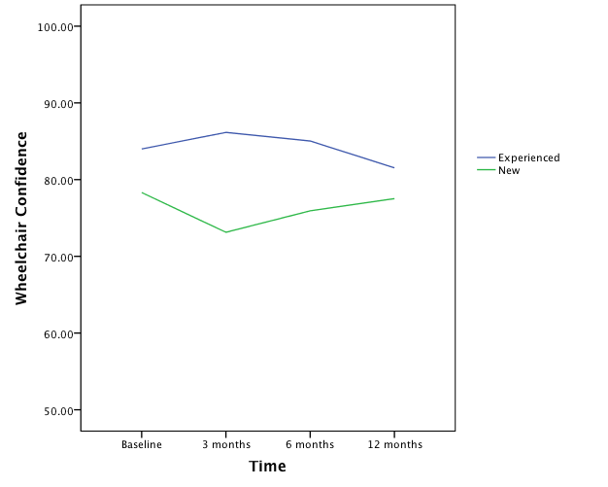
Experienced PWUs are More Confident than New PWUs
P2: Natural Hx & Measurement
Notes:
Wheelchair confidence is higher for experienced PWUs than for new PWUs.
For new PWUs wheelchair confidence drops from baseline to 3 months… probably as one begins to experience more aspects of their lives in a wheelchair and realizes the actual ‘task demands’ required.
Quite high for both groups.

Slide 28
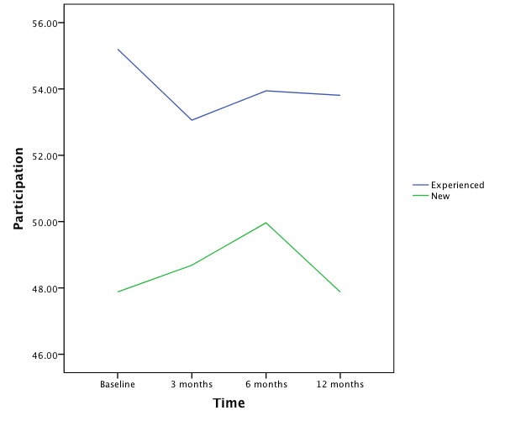
Participation is Greater in Experienced PWUs
P2: Natural Hx & Measurement
Notes:
ATOP measures the specific functional effects of mobility assistive devices, such as canes, orthotics, walkers and wheelchairs, on performance of mobility-related activities and participation as defined by the ICF (WHO, 2001)
Under the ICF, the mobility device is an environmental factor that is supposed to facilitate the performance of activities and allow the person to perform life roles that he or she values, referred to as participation.
The mobility device can also become an obstacle in certain situations where the built environment is not well adapted.
One of the questions that CanWheel wants to address with the ATOP is in what situations does the power wheelchair enable participation and in what situations does it impede participation compared to when the person is not using the device. This is possible with the ATOP because the person answers a series of questions considering the use of the device and the same series of questions without any mobility device. (show the 5-level response scale).
The extent to which the score of the participant is higher or lower than 50 allows to compare his ability to the population of 1037 users of mobility devices that were assessed with the ATOP/M;
we expect that 68% of device users’ scores range between 40 and 60.
The “participation with devices” of experienced PWUs is slightly above the average of mobility device users when all categories of devices are considered. The mean scores of new PWUs are below the average T score of 50.
ATOP measures the impact of mobility devices on activity and participation. Specifically, how much difficulty one has in performing a task with and without use of mobility devices. Participation (discretionary social participation and social role performance). T score.
Participation average in Experienced PWUs and below average for New PWUs.

Slide 29
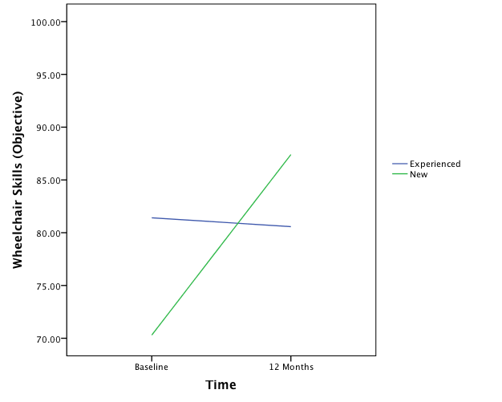
Wheelchair Skill Capacity Improves Over Time for New PWUs
P2: Natural Hx & Measurement

Slide 30
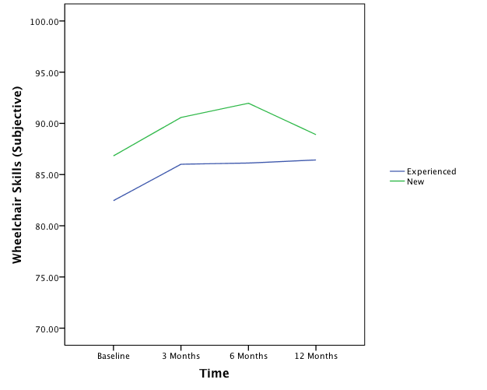
Subjective Wheelchair Skill Capacity is Higher for New PWUs
P2: Natural Hx & Measurement

Slide 31
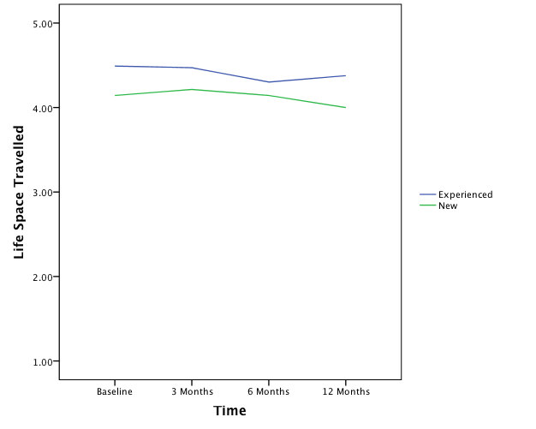
Experienced PWUs Travel to Farther Life Spaces
P2: Natural Hx & Measurement
Notes:
The LSA measures frequency and independency of mobility across a continuum of environments through which a person reports moving during the prior 4 weeks. From bedroom to own home to around own home (e.g, yard), to one’s neighborhood, outside one’s neighborhood, but within one’s town, to outside one’s town.
Maximal life-space - the greatest distance attained with the help of devices and/or persons if needed. The higher the score, the greater the life space travelled.

Slide 32
CATOM Graph…
P2: Natural Hx & Measurement
… just waiting for data to make CATOM graph… & will also add demographics slide

Slide 33
Discussion
P2: Natural Hx & Measurement
Implications
Important considerations for clinicians
Research implications
Future directions

Slide 34
Acknowledgement
P2: Natural Hx & Measurement

